Slide 1
Email Classification
Team Ravana
Team Members
Cliffton Fernandes
Nikhil Keswaney
Notes:
Hi

Slide 2
Hello!
Cliffton Fernandes
MS-CS
Nikhil Keswaney
MS-CS

Slide 3
Topic Area
Email Classification
Spam: Unsolicited Junk Mail
Ham : Desired emails and not spam.
Accuracy improves with increase in processed data.
Enron Corpus ( 500k Emails)
Large amount of computational resources and time.
Parallel computing can be used to reduce the amount of time.
Notes:
Email Classification
Spam: Unsolicited Junk Mail
Ham : Desired emails and not spam.
Accuracy improves with increase in processed data.
Large datasets require large amount of computational resources and time.
Parallel computation techniques can be used to reduce the amount of time required to classify a large dataset of emails.

Slide 4
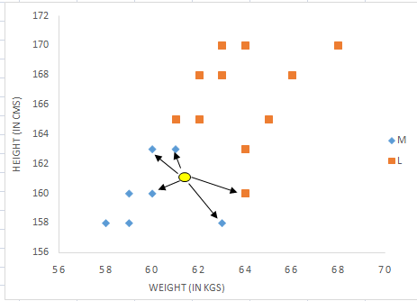
Approach
K - Nearest Neighbours Algorithm.
Classification algorithm.
Example of KNN.

Slide 5
Problems Addressed
Implementing KNN (K nearest Neighbour) using TF-IDF (Term Frequency - Inverse Document Frequency) for weight matrix calculation.
Benchmarking the implemented technique.

Slide 6
Novel Contributions
TF-IDF (Term Frequency - Inverse Document Frequency)
What is TF-IDF?
TDIDF is a numerical statistic method which allows the determination of weight for each term in each document.
This method is often used in NLP or in information retrieval and text mining.
This method evaluates importance of terms (Words) in document collection.
The importance of the text is increased proportionally to the number of appearing in the documents.

Slide 7
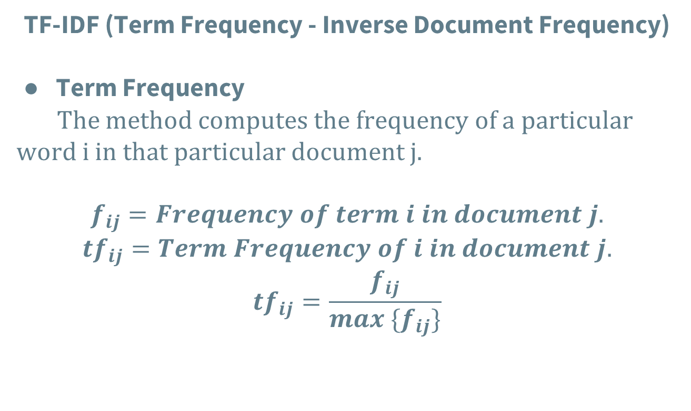
Novel Contributions
TF-IDF (Term Frequency - Inverse Document Frequency)
Term Frequency
The method computes the frequency of a particular word i in that particular document j.
$$f_{ij}=Frequency of term i in document j.$$
$${tf}_{ij}=Term Frequency of i in document j.$$
$${tf}_{ij}=\frac{f_{ij}}{max \{f_{ij}\}}$$

Slide 8
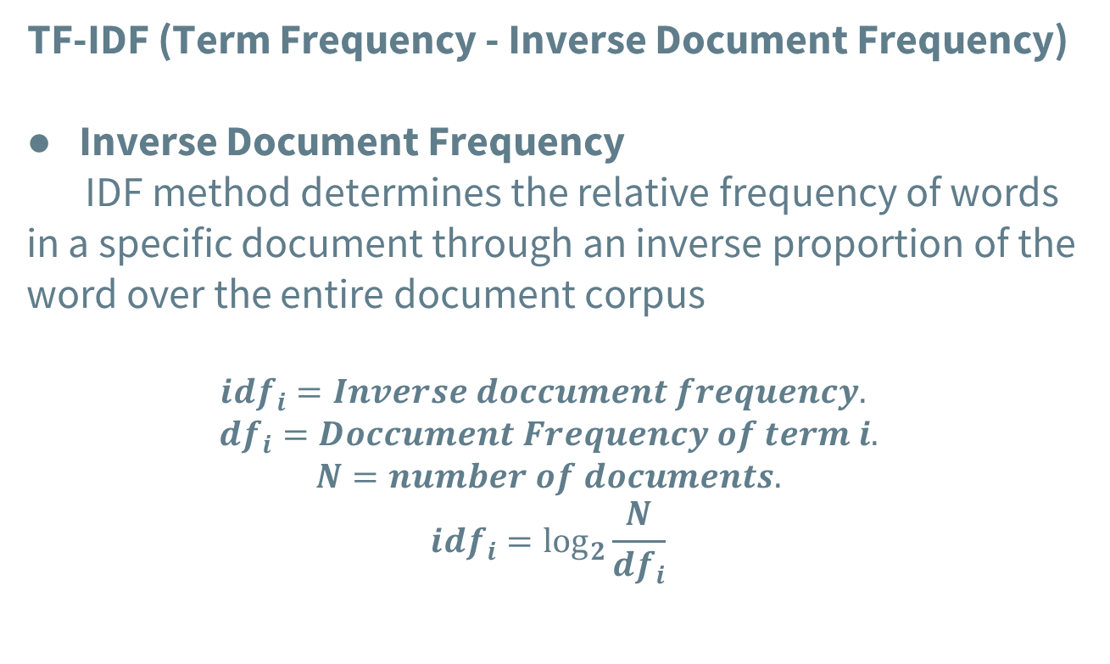
Novel Contributions
TF-IDF (Term Frequency - Inverse Document Frequency)
Inverse Document Frequency
IDF method determines the relative frequency of words in a specific document through an inverse proportion of the word over the entire document corpus
$${idf}_{i}=Inverse doccument frequency.$$
$${df}_{i}=Doccument Frequency of term i.$$
$$N=number of documents.$$
$${idf}_{i}=\log_{2}{\frac{N}{{df}_{i}}}$$

Slide 9
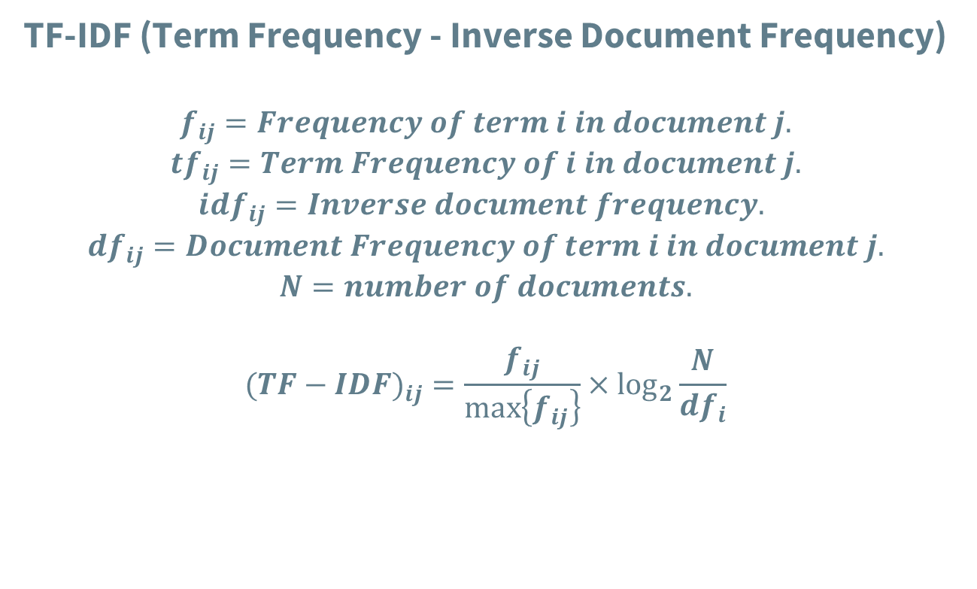
Novel Contributions
TF-IDF (Term Frequency - Inverse Document Frequency)
$$f_{ij}=Frequency of term i in document j.$$
$${tf}_{ij}=Term Frequency of i in document j.$$
$${idf}_{ij}=Inverse document frequency.$$
$${df}_{ij}=Document Frequency of term i in document j.$$
$$N=number of documents.$$
$$({TF−IDF)}_{ij}=\frac{f_{ij}}{\max\left\{f_{ij}\right\}}×\log_{2}{\frac{N}{{df}_{i}}}$$

Slide 10

Example of TF-IDF matrix.
$$1−Spam$$
$$0−Ham$$
$$2−Unclassified$$
Email | Cheap | Purchase | Contract | ... | Submitted | Answer
1 | 8.23 | 0.12 | 0 | ... | 9.45 | 1
2 | 1.22 | 0 | 0 | ... | 7.1 | 0
3 | 0 | 0 | 1 | ... | 0 | 1
4 | 0.0012 | 11.22 | 3.22 |  | 0.99 | 2
... | ... | ... | ... | ... | ... | ...
500000 | 7.22 | 4.11 | 0 | ... | 0 | 2

Slide 11
Sequential program

Slide 12
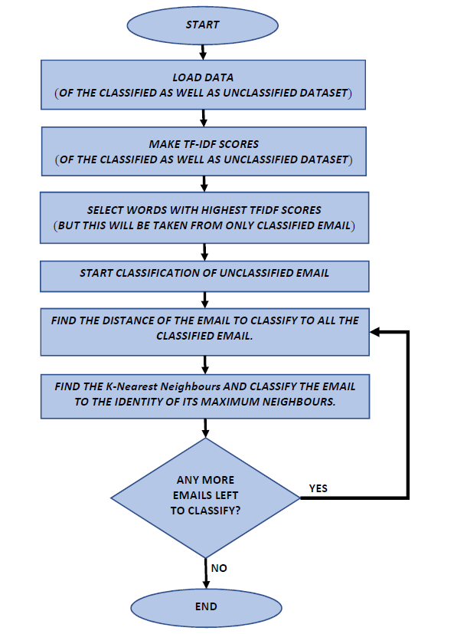

Slide 13
Parallel program

Slide 14
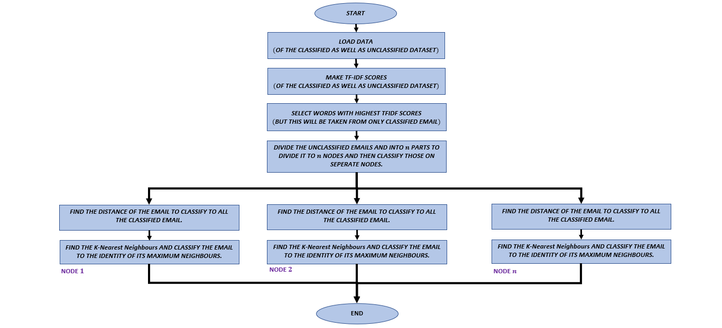

Slide 15
DEMONSTRATION.

Slide 16
Thanks!
Any questions?

